Slide 1
Analysis of Time Series Models for Electricity Consumption Forecasting
Qianqian Yao
Notes:
My project is titled as …

Slide 2
Contents
Background of Time Series Analysis
Project motivation
Data
Models
Conclusion
Notes:
During this project,

Slide 3
Background of Time Series Analysis
A Time Series is a collection of observations $x_{t}$, each of which is indexed by time t, ie., the observation $x_{t}$ is made at a specific time t.
A Time Series Model for the observed data {$x_{t}$} is a specification of the joint distributions (or possibly only the mean and covariance) of a sequence of random variables {$X_{t}$} of which {$x_{t}$} is postulated to be a realization.
Objectives of Time Series Analysis: Modeling and Forecasting
1- set up a probability model to represent data;
2- estimate parameters in the model;
3- check the goodness of the model fit for the data;
4- use the fitted model to enhance our understanding of the mechanism generating the series;
5- once the probability model has been established, we may use it to summarize the data or forecast (predict) the future values, etc.
Notes:
What is outliers?
Outliers and anomalies can be used interchangeably.

Slide 4
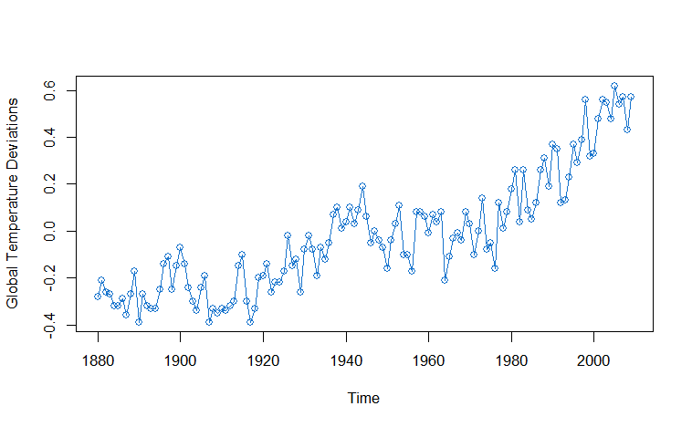
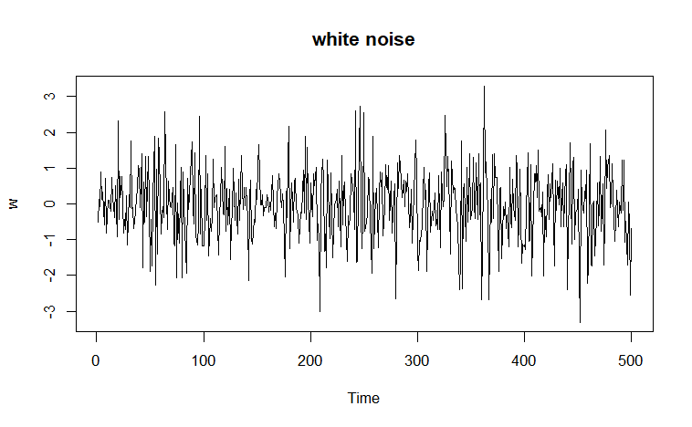
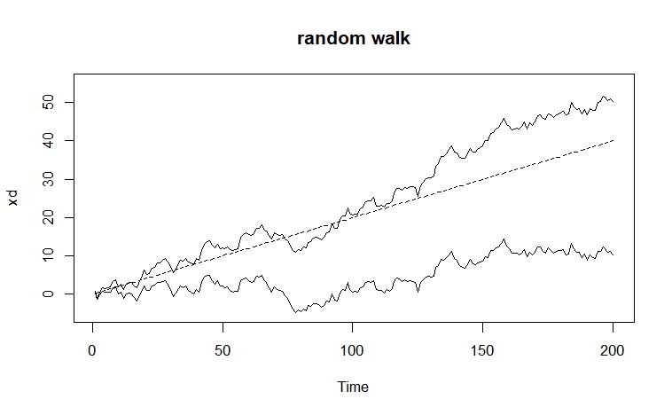
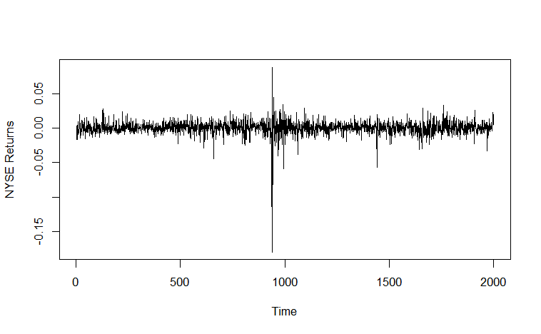
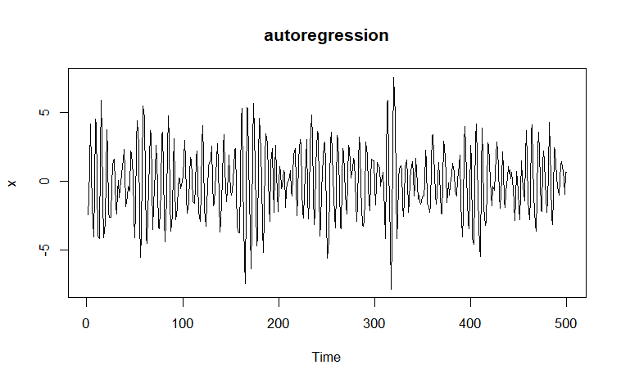
Background of Time Series Analysis
Real World Examples
Model Generated Examples
Global warming
New Yorker Stock Exchange

Slide 5
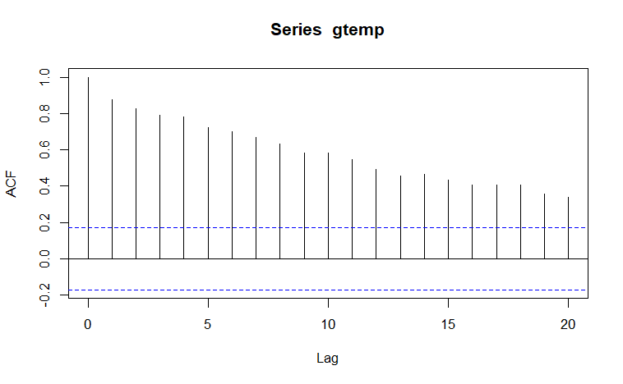
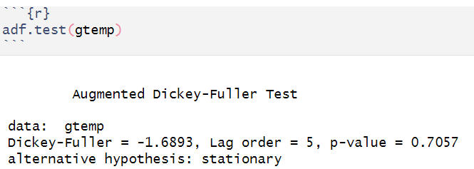
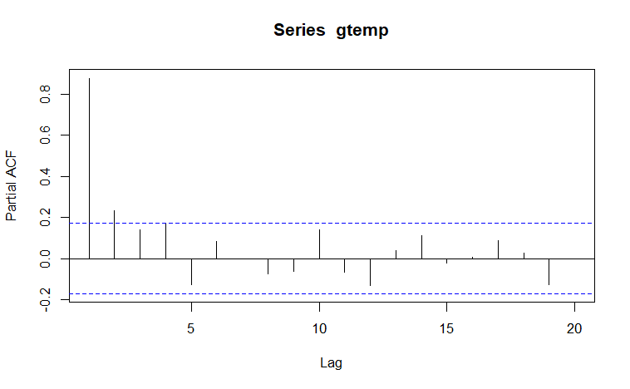
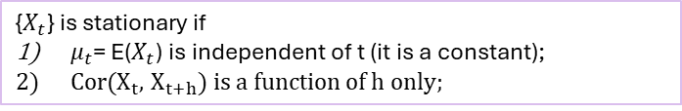
Stationary
Background of Time Series Analysis
{$X_{t}$} is stationary if
$μ_{t}$= E($X_{t}$) is independent of t (it is a constant);
Cor($X_{t}$, $X_{t+h}$) is a function of h only;
This condition makes sure the data are homogeneous,
so that the data can be modeled.
The ways to check stationary: Dickey Fuller, ACF & PACF
Global warming
Notes:
After the data is obtained, the first step is to check stationary,
Stationary is …to make sure the data has constant mean values and covariances is independent from time.
The method to check stationary ..
Then we can plot ACF and PACF, which are two methods to check data correlationships.

Slide 6
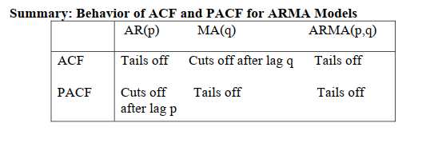
Background of Time Series Analysis
Tails off
Modeling selection for Global Warming: AR(2)
We are not sure whether there are other models appropriate for Global Warming
Cut off after lag=2
Notes:
By the characteristics of ACF and PACF, we can choose a model for it.

Slide 7
Project Motivation
To address climate change, we can discover catalysts to develop new energy resources, on the other hand we also should save the current energy resources.
Predicting the electric power consumption precisely on demand can save energy.
The electric power distribution problem is the distribution of electricity to different areas depends on its sequential usage, but predicting the following demand of a specific area is difficult, as it varies with weekdays, holidays, seasons, weather, temperatures, etc.
It causes unnecessary waste of electricity and equipment depreciation.
There is one efficient strategy to solve this problem is to predict the electrical transformers’ oil temperature because the oil temperature can reflect the electricity transformer. So that we can predict electric power consumption precisely.
The dataset is historical records of oil temperatures measured at electricity distribution stations.
This project focuses on time series data analysis, forecasting model selection and evaluation.
https://github.com/zhouhaoyi/ETDataset
Notes:
to predict the electrical transformers’ oil temperature because the oil temperature can reflect the electricity transformer. So that we can predict electric power consumption precisely

Slide 8
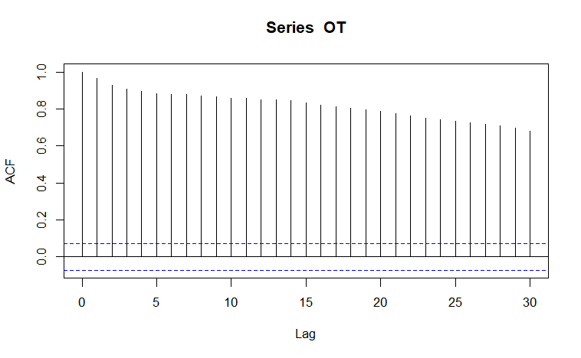
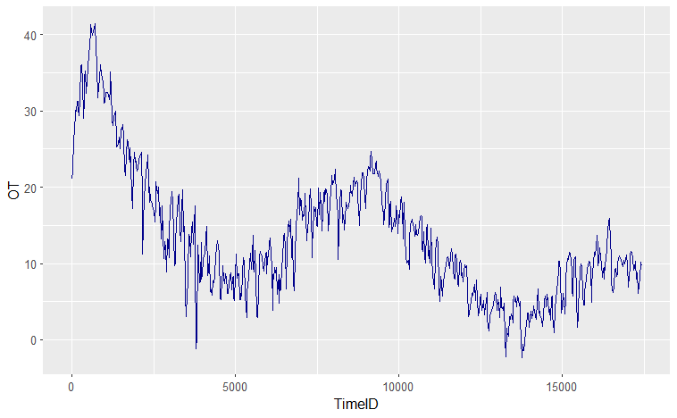
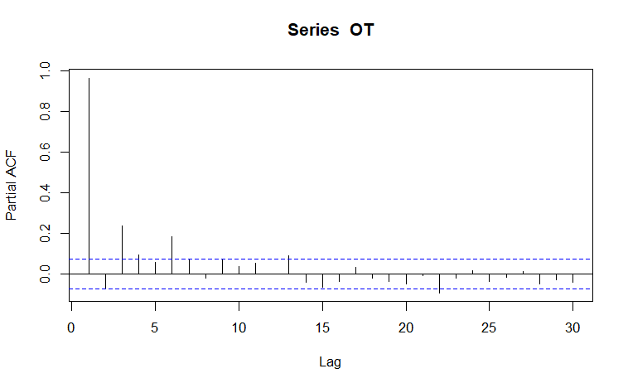
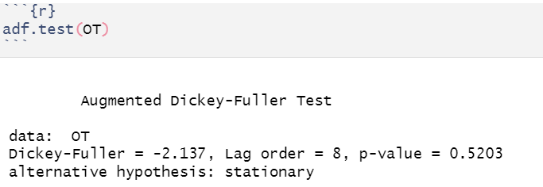
Data
Time | HUFL | HULL | MUFL | MULL | LUFL | LULL | OT
Days | High Useful Load | High Useless Load | Middle Useful Load | Middle Useless Load | Low Useful Load | Low Useless Load | Oil Temperature
Tail off
Cut off at lag 6
Notes:
The dataset contains total 7 variables:
Tested stationary of oil temperature,
Checked ACF PACF

Slide 9
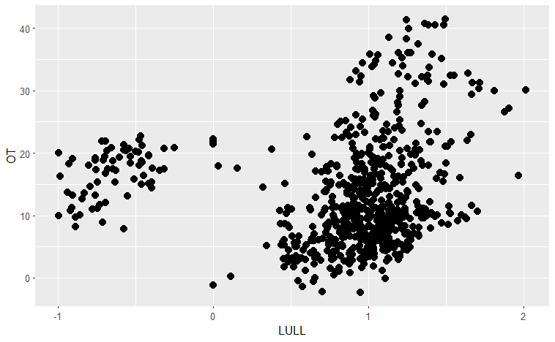
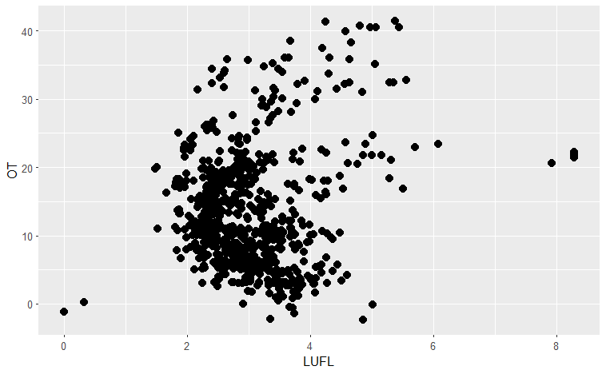
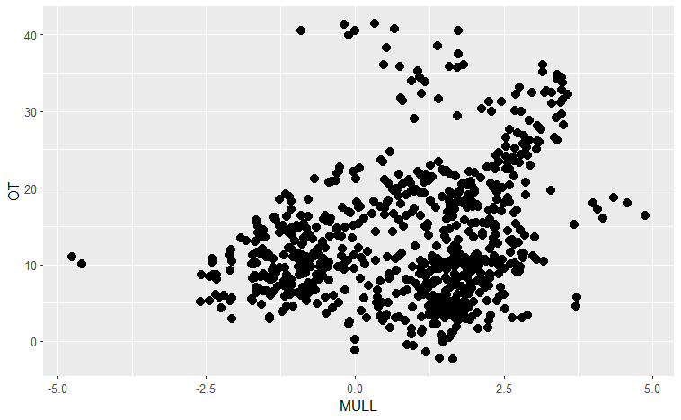
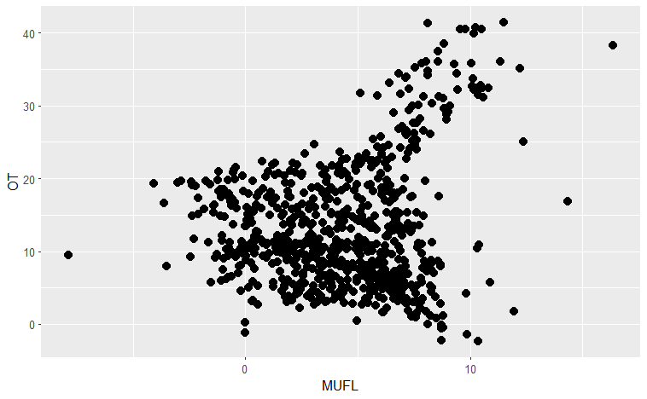
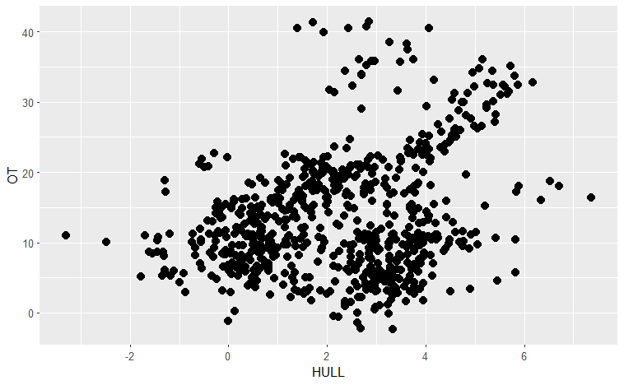
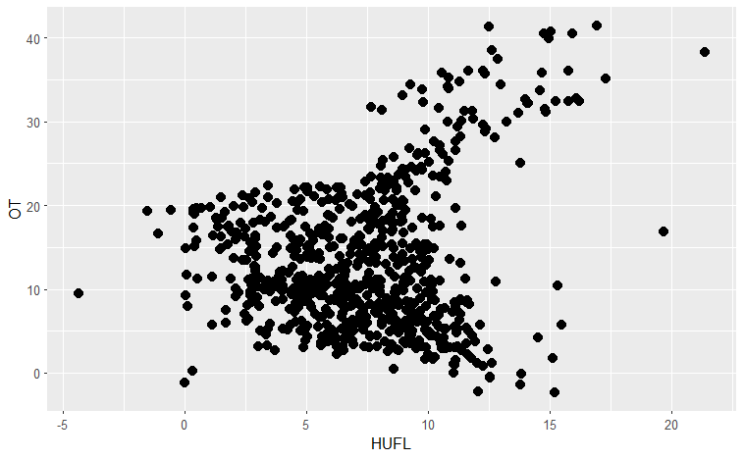
Data
Time | HUFL | HULL | MUFL | MULL | LUFL | LULL | OT
Days | High Useful Load | High Useless Load | Middle Useful Load | Middle Useless Load | Low Useful Load | Low Useless Load | Oil Temperature
LULL
LUFL
MULL
MUFL
HULL
HUFL

Slide 10
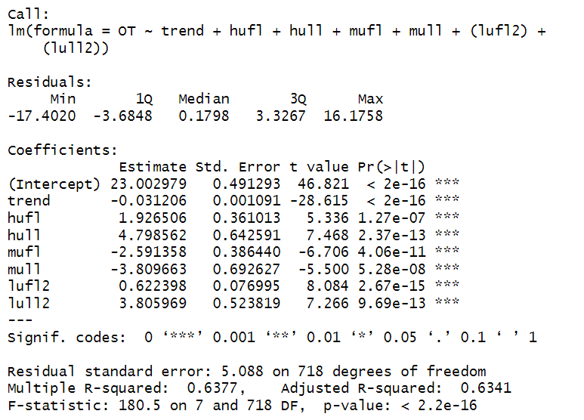
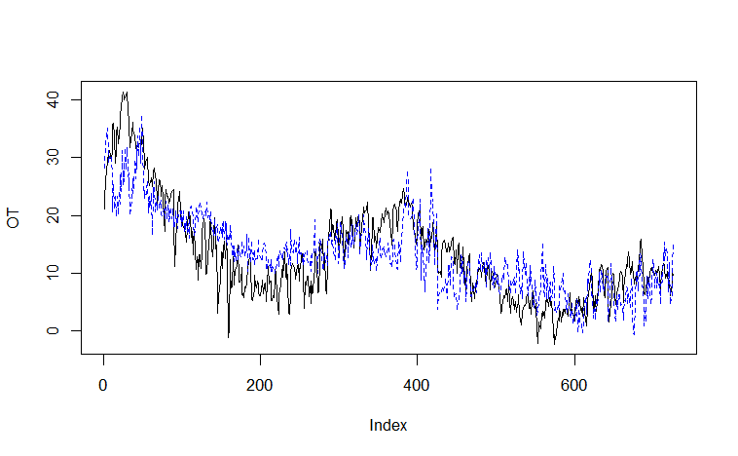
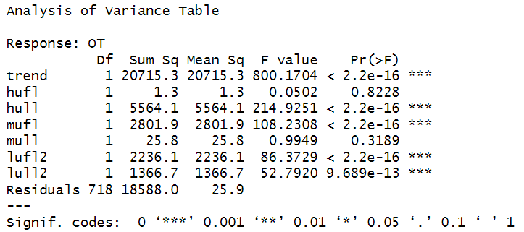
Models: Linear Regression
polynomial regression at degree 2
Notes:
First, polynomial regression model at degree 2 are tried.

Slide 11
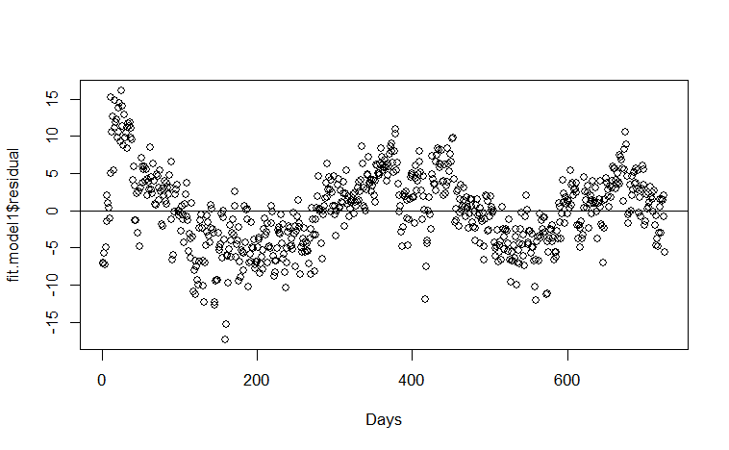
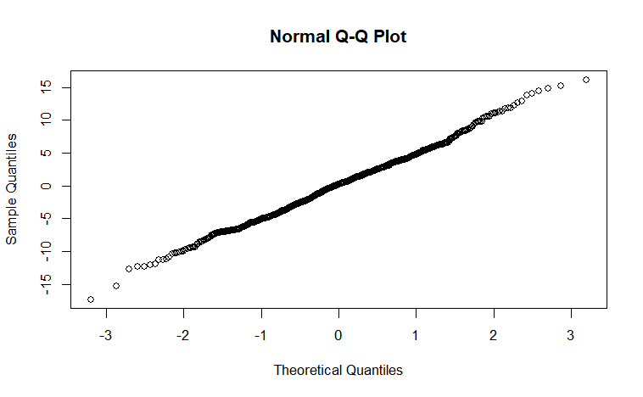
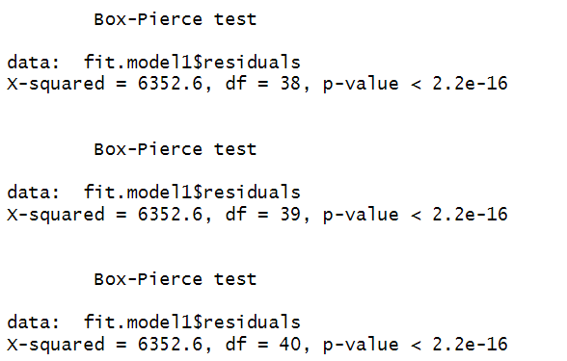
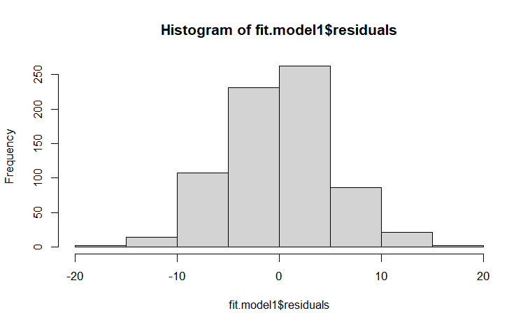
Models: Linear Regression
Check Residual IID
Check Residual Normality
Normal
Not IID

Slide 12
Models: Linear Regression
fit.model1 <- lm(OT ~ trend + hufl + hull + mufl + mull + (lufl2) + (lull2))
fit.model2 <- lm(OT ~ trend + hufl + hull + mufl + mull + (lufl +lufl2) + (lull +lull2))
fit.model3 <- lm(OT ~ trend + (hufl+hufl2) + (hull+hull2) + (mufl+mufl2) + (mull+mull2) + (lufl+lufl2) + (lull+lull2))
Model | AIC | BIC | AICc
Model_1 | 4.2675 | 4.3244 | 4.2594
Model_2 | 4.2669 | 4.3364 | 4.2533
Model_3 | 4.2515 | 4.3463 | 4.2269

Slide 13
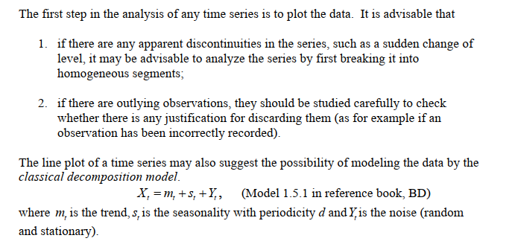
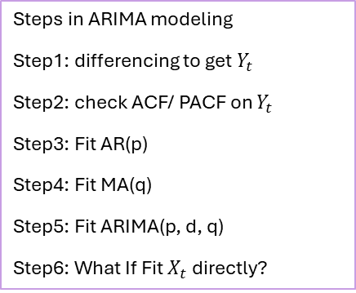
Models: ARIMA
Time series of Oil Temperature
Steps in ARIMA modeling
Step1: differencing to get $Y_{t}$
Step2: check ACF/ PACF on $Y_{t}$
Step3: Fit AR(p)
Step4: Fit MA(q)
Step5: Fit ARIMA(p, d, q)
Step6: What If Fit $X_{t}$ directly?
Notes:
Then arima model is tried to model time series of oil temperature.
There is a classical decomposition model:
The very first step is to process data to remove trend and seasonality .

Slide 14
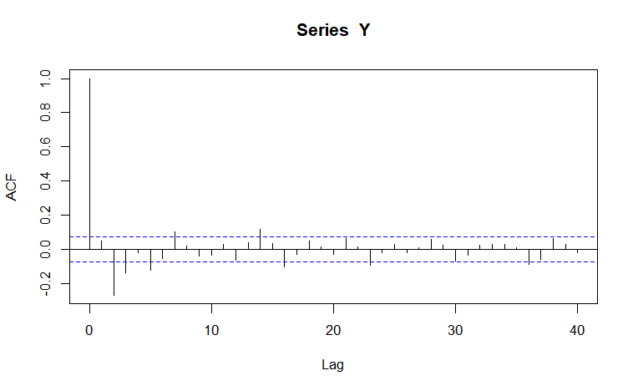
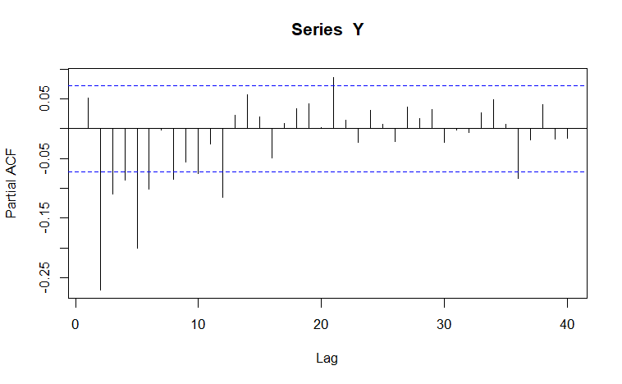
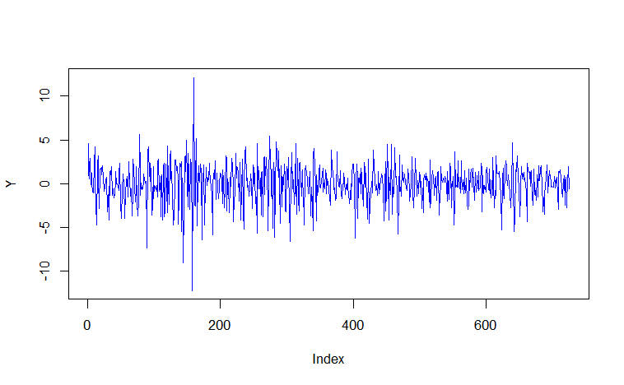



Models: ARIMA
differencing to get $Y_{t}$= $X_{t}$ - $X_{t−1}$
Cut off at lag 2
MA(q = 2)
$$X_{t}$$
Before
$$Y_{t}$$
After
AR(p = 8)
Cut off at lag 8
Notes:
After differencing on xt, we can see how yt and xt look like by comparison.
Yt is basically a white noise.
Then acf and pacf are ploted for yt. Both of them have cut off characteristics,
Acf cut off at lag 2, pacf cut off at lag 8.
Then we can try the following different arima models.

Slide 15
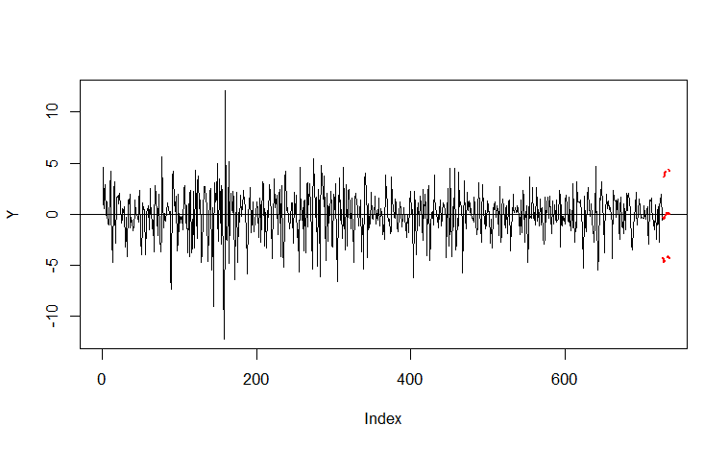
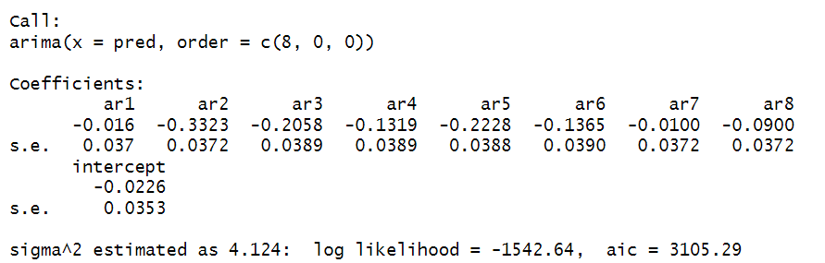
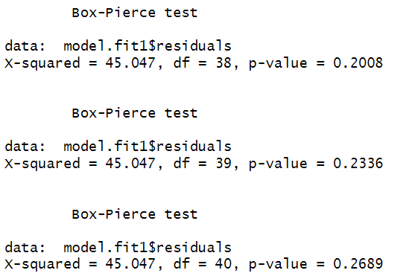
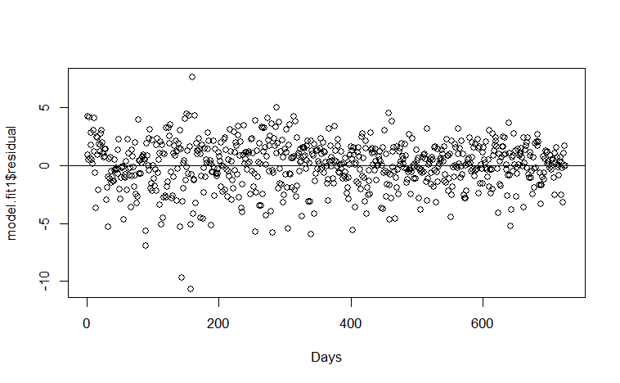
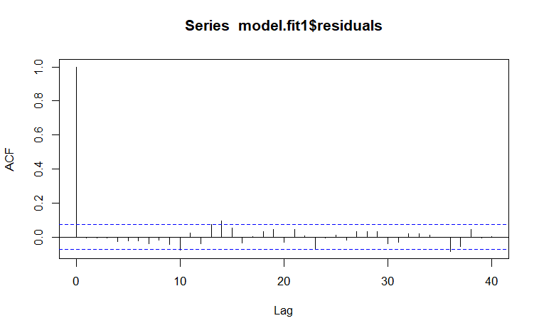
AR(p = 8)
model.fit1 <- arima(Y, order=c(8, 0, 0))
IID
Normal
Notes:
The first is ar at lag 8.
Fit the data, predict, then check residual assumptions.

Slide 16
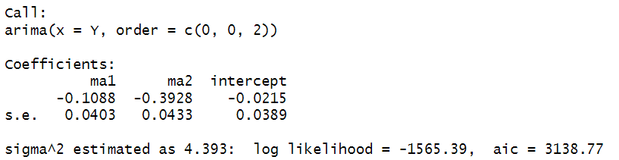
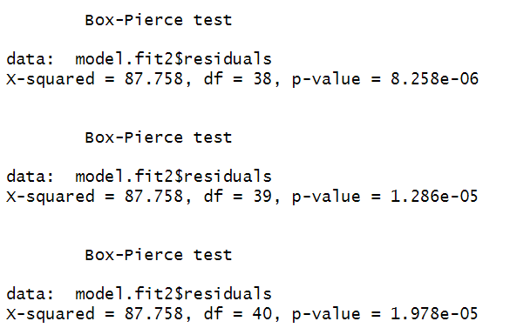
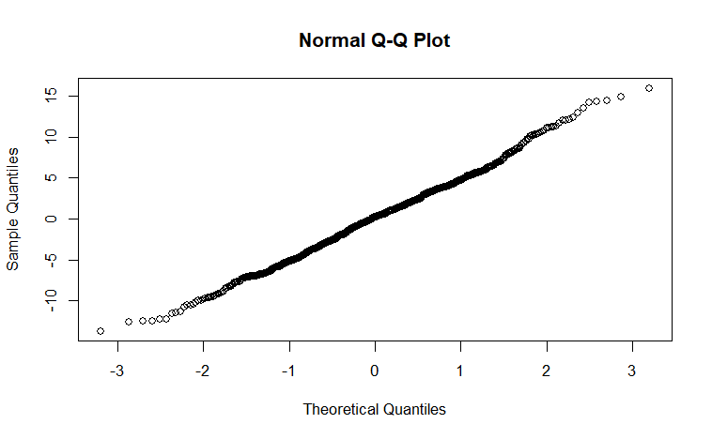
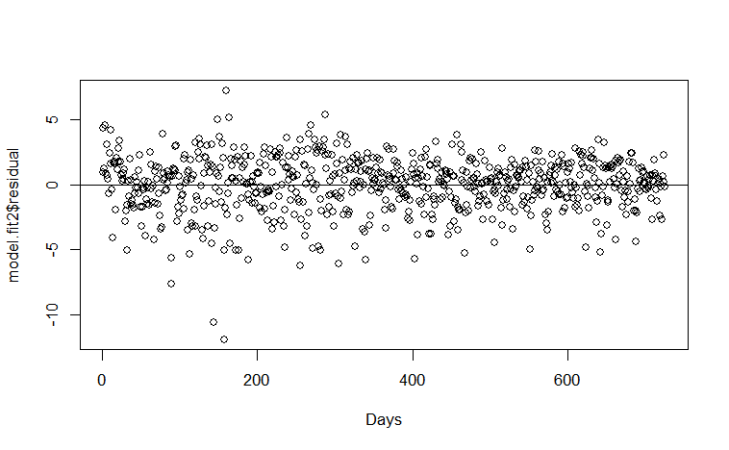
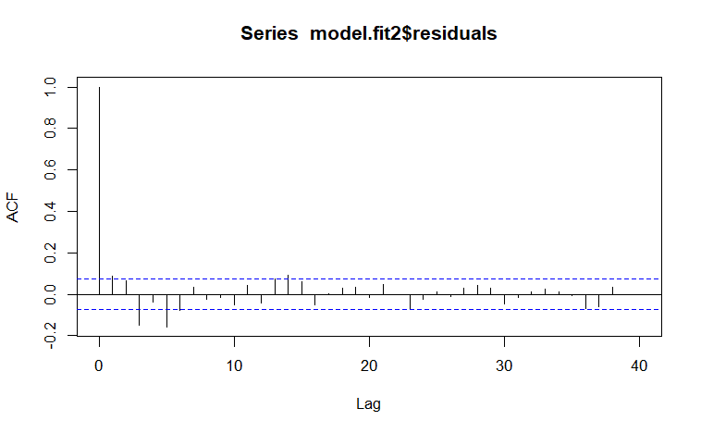
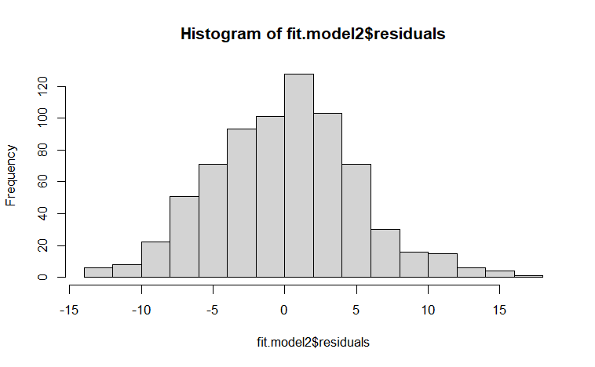
MA(q = 2)
model.fit2 <- arima(Y, order=c(0, 0, 2))
Not IID
Normal
Notes:
Same process as ma at lag 2

Slide 17
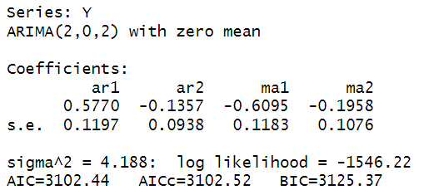
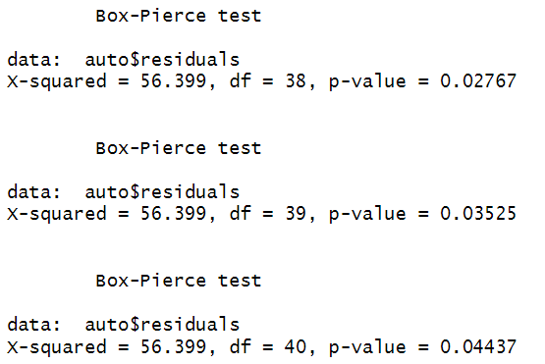
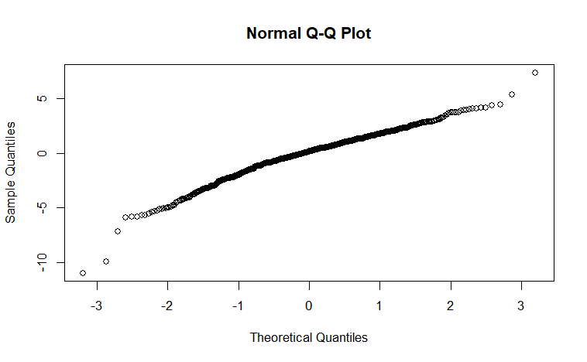
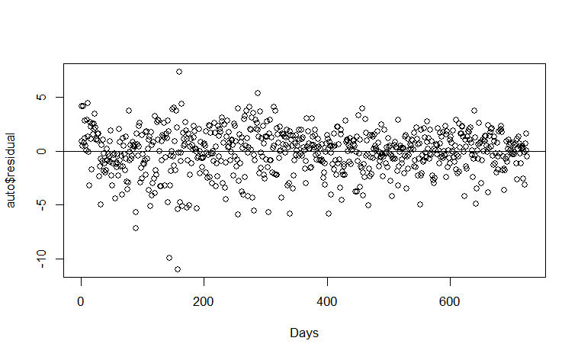
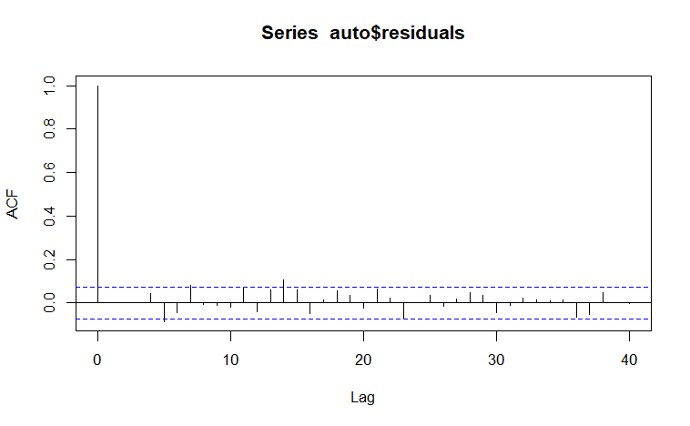
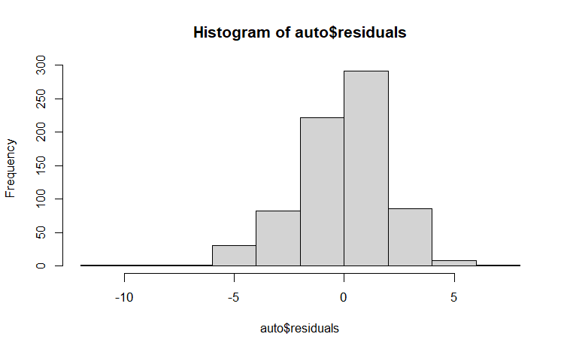
ARIMA(p, d, q)
auto <- auto.arima(Y, d=0, ic="aicc", trace=T)
IID
Normal
Notes:
Same process for arima, by auto.arima() function in R, the algorithm can find the best choise of p, d, q,

Slide 18
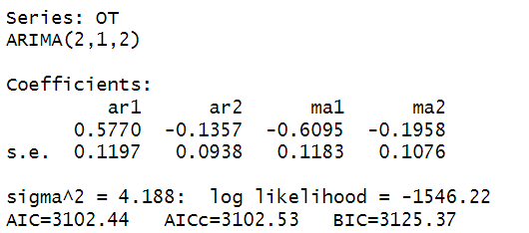






ARIMA(p, d, q) on $X_{t}$
OT.fit1 <- auto.arima(OT, trace=T, ic="aicc")
IID
Normal

Slide 19

model.fit1 <- arima(Y, order=c(8, 0, 0))
num <- length(OT)
# AIC
AIC(OT.fit1)/num - log(2*pi)
# BIC
AIC(OT.fit1, k=log(num))/num - log(2*pi)
# AICc
log(sum(resid(OT.fit1)^2)/num) + (num +5)/(num -5 -2)
model.fit2 <- arima(Y, order=c(0, 0, 2))
auto <- auto.arima(Y, d=0, ic="aicc", trace=T)
auto2 <- auto.arima(Y, ic="aicc", trace=T)
OT.fit1 <- auto.arima(OT, trace=T, ic="aicc")
Model | AIC | BIC | AICc
AR(p = 8) on $Y_{t}$ | 2.4394 | 2.5026 | 2.4322
MA(q = 2) on $Y_{t}$ | 2.4855 | 2.5108 | 2.4952
ARIMA(2,0,2) on $Y_{t}$ | 2.4354 | 2.4670 | 2.4421
ARIMA(2,1,2) on $X_{t}$ | 2.4354 | 2.4670 | 2.4421

Slide 20

Conclusion
Linear Regression Models
Residual Assumption of IID is not satisfied, add more feature couldn’t improve the model performance obviously,
so linear regression model may not a good choice.
ARIMA
Among AR, MA, ARIMA, ARIMA model performs better.
Process on decomposed $Y_{t}$: ARIMA(2, 0, 2) is the best choice.
Process on Original $X_{t}$: ARIMA(2, 1, 2) is the best choice.
Which make sense, because d =1 is the “on step differencing” from $X_{t}$ to get $Y_{t}$
More details will be covered in final report
Causality, invertibility,
ARFIMA (long memory process)
Check whether ARCH, GARCH model are applicable

Slide 21
THANKS
Q & A

